Slide 1



Slide 2
Ai201: Introduction to AI Section Three

Slide 3
What is a Class in Python?
In Python, a class is a user defined entity (data types) that defines the type of data an object can contain and the actions it can perform.
It is used as a template for creating objects.

Slide 4
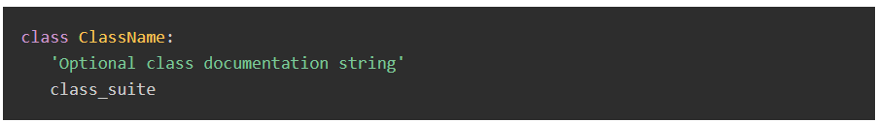
Creating Classes in Python

Slide 5
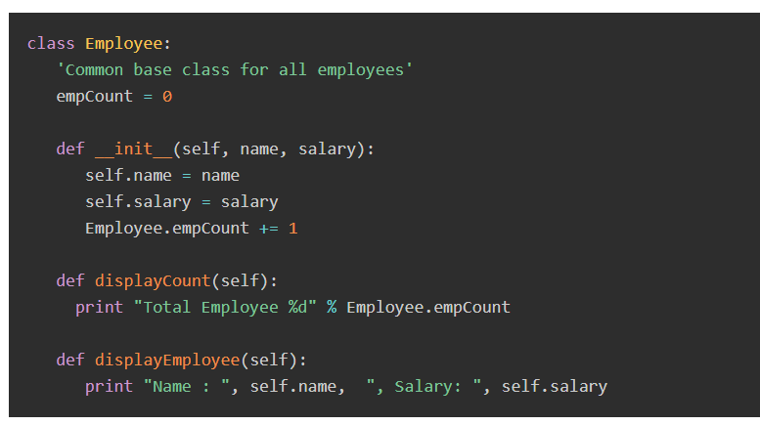
Example
Notes:
class Employee:
'Common base class for all employees'
empCount = 0
def __init__(self, name, salary):
self.name = name
self.salary = salary
Employee.empCount += 1
def displayCount(self):
print "Total Employee %d" % Employee.empCount
def displayEmployee(self):
print "Name : ", self.name, ", Salary: ", self.salary

Slide 6
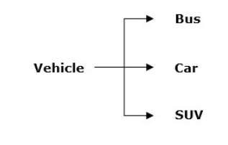
What is an Object?
An object is referred to as an instance of a given Python class.
Each object has its own attributes and methods, which are defined by its class.
When a class is created, it only describes the structure of objects.
The memory is allocated when an object is instantiated from a class.

Slide 7
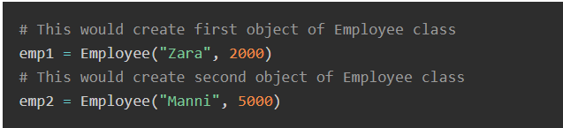
Creating Objects of Classes in Python

Slide 8
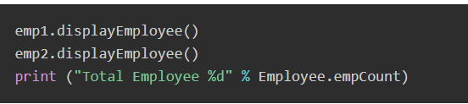
Accessing Attributes of Objects in Python
Notes:
class Employee:
"Common base class for all employees"
empCount = 0
def __init__(self, name, salary):
self.name = name
self.salary = salary
Employee.empCount += 1
def displayCount(self):
print ("Total Employee %d" % Employee.empCount)
def displayEmployee(self):
print ("Name : ", self.name, ", Salary: ", self.salary)
# This would create first object of Employee class
emp1 = Employee("Zara", 2000)
# This would create second object of Employee class
emp2 = Employee("Manni", 5000)
emp1.displayEmployee()
emp2.displayEmployee()
print ("Total Employee %d" % Employee.empCount)

Slide 9
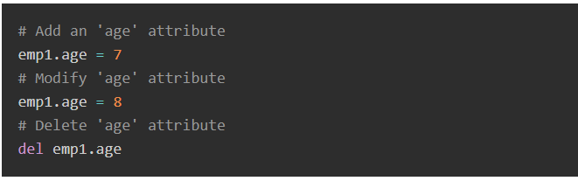
You can add, remove, or modify attributes of classes and objects at any time

Slide 10
Instead of using the normal statements to access attributes, you can also use the following functions
getattr(obj, name[, default]) − to access the attribute of object.
hasattr(obj,name) − to check if an attribute exists or not.
setattr(obj,name,value) − to set an attribute. If attribute does not exist, then it would be created.
delattr(obj, name) − to delete an attribute.

Slide 11
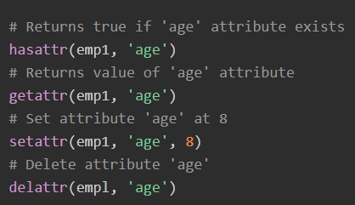
Example
Notes:
# Returns true if 'age' attribute exists
hasattr(emp1, 'age')
# Returns value of 'age' attribute
getattr(emp1, 'age')
# Set attribute 'age' at 8
setattr(emp1, 'age', 8)
# Delete attribute 'age'
delattr(empl, 'age')

Slide 12
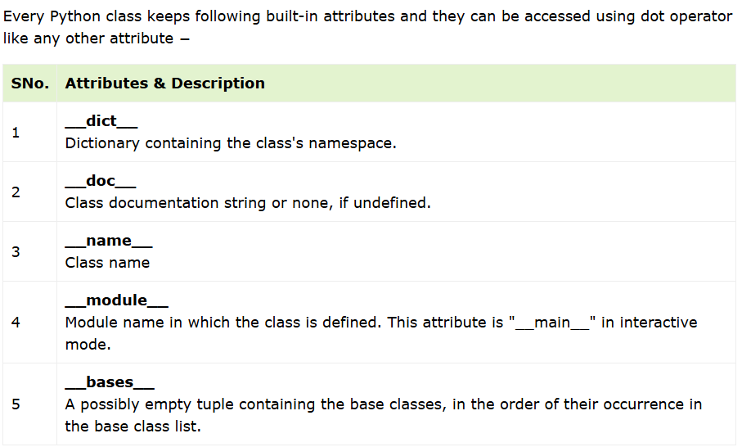
Built-In Class Attributes in Python

Slide 13
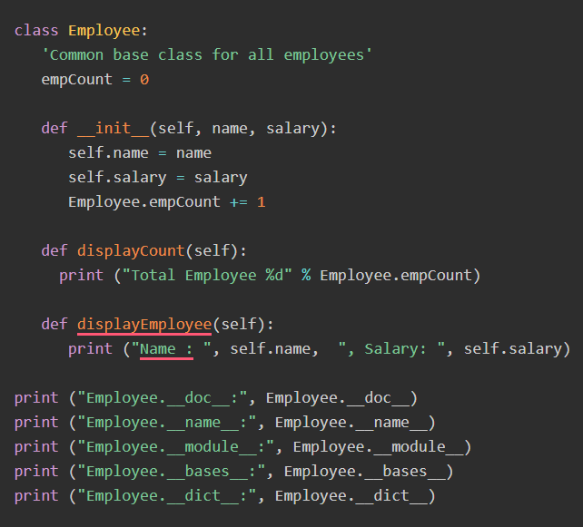
Example For the above Employee class, let us try to access its attributes :
Notes:
class Employee:
'Common base class for all employees'
empCount = 0
def __init__(self, name, salary):
self.name = name
self.salary = salary
Employee.empCount += 1
def displayCount(self):
print ("Total Employee %d" % Employee.empCount)
def displayEmployee(self):
print ("Name : ", self.name, ", Salary: ", self.salary)
print ("Employee.__doc__:", Employee.__doc__)
print ("Employee.__name__:", Employee.__name__)
print ("Employee.__module__:", Employee.__module__)
print ("Employee.__bases__:", Employee.__bases__)
print ("Employee.__dict__:", Employee.__dict__)

Slide 14
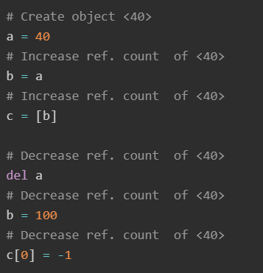
Garbage Collection(Destroying Objects) in Python
Python deletes unwanted objects (built-in types or class instances) automatically to free the memory space.
The process by which Python periodically reclaims blocks of memory that no longer are in use is termed Garbage Collection.

Slide 15
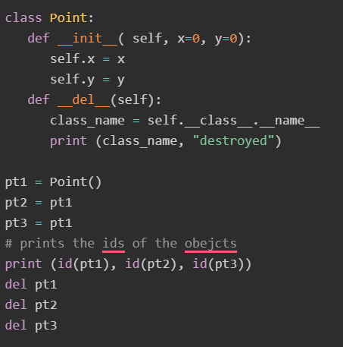
Example
The __del__() destructor prints the class name of an instance that is about to be destroyed as shown in the below code block:
Notes:
class Point:
def __init__( self, x=0, y=0):
self.x = x
self.y = y
def __del__(self):
class_name = self.__class__.__name__
print (class_name, "destroyed")
pt1 = Point()
pt2 = pt1
pt3 = pt1
# prints the ids of the obejcts
print (id(pt1), id(pt2), id(pt3))
del pt1
del pt2
del pt3

Slide 16
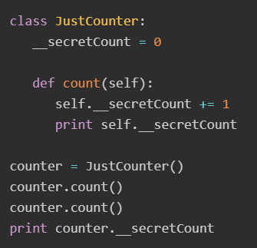

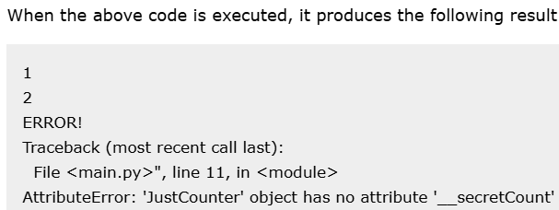
Data Hiding in Python
Python protects those members by internally changing the name to include the class name.
You can access such attributes as object._className__attrName.
If you would replace your last line as following, then it works for you
Notes:
class JustCounter:
__secretCount = 0
def count(self):
self.__secretCount += 1
print self.__secretCount
counter = JustCounter()
counter.count()
counter.count()
print counter.__secretCount

Slide 17
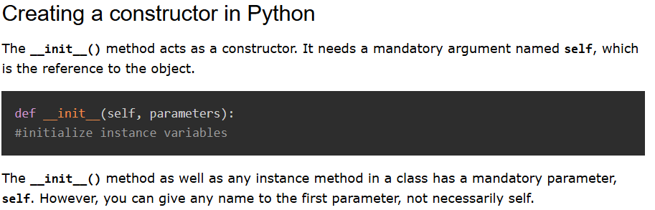
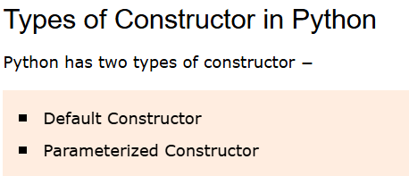
Python Constructors

Slide 18
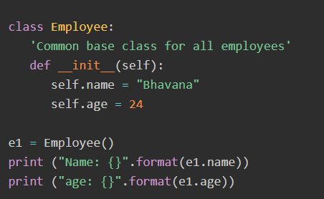
Default Constructor in Python
Notes:
class Employee:
'Common base class for all employees'
def __init__(self):
self.name = "Bhavana"
self.age = 24
e1 = Employee()
print ("Name: {}".format(e1.name))
print ("age: {}".format(e1.age))

Slide 19
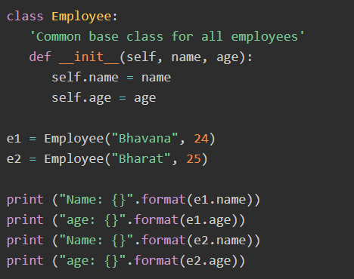
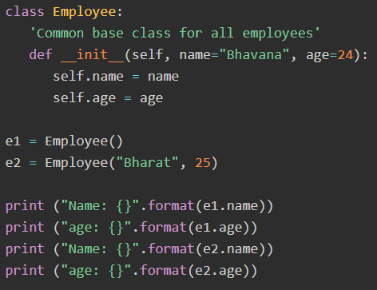
Parameterized Constructor
Notes:
class Employee:
'Common base class for all employees'
def __init__(self, name, age):
self.name = name
self.age = age
e1 = Employee("Bhavana", 24)
e2 = Employee("Bharat", 25)
print ("Name: {}".format(e1.name))
print ("age: {}".format(e1.age))
print ("Name: {}".format(e2.name))
print ("age: {}".format(e2.age))

Slide 20
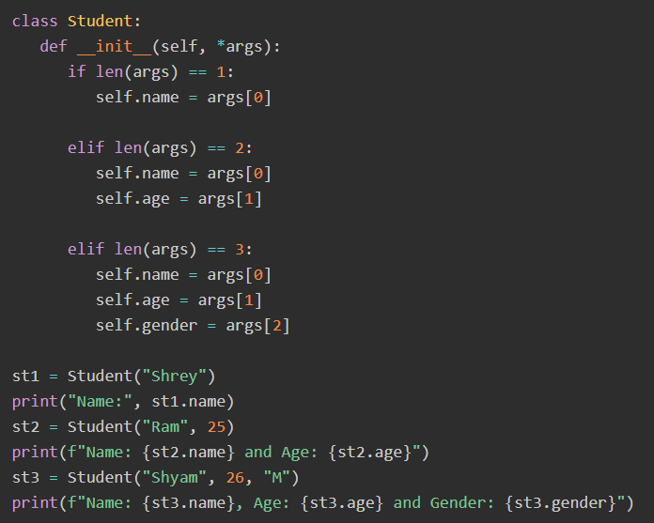
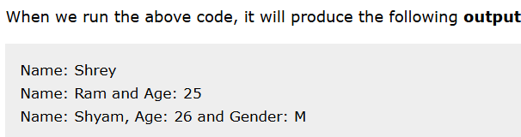
Python Multiple Constructors

Slide 21
For more about Classes and Objects visit ➔ https://www.tutorialspoint.com/python/python_constructors.htm

Slide 22
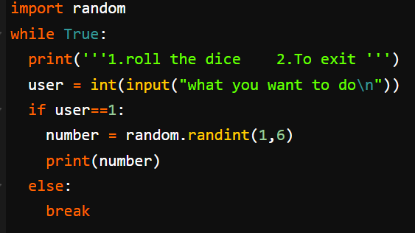
Rolling Die Python Code Using Random
Your Task➔ Develop class die that gives you the same results without using random
Notes:
import random
while True:
print('''1.roll the dice 2.To exit ''')
user = int(input("what you want to do\n"))
if user==1:
number = random.randint(1,6)
print(number)
else:
break

Slide 23
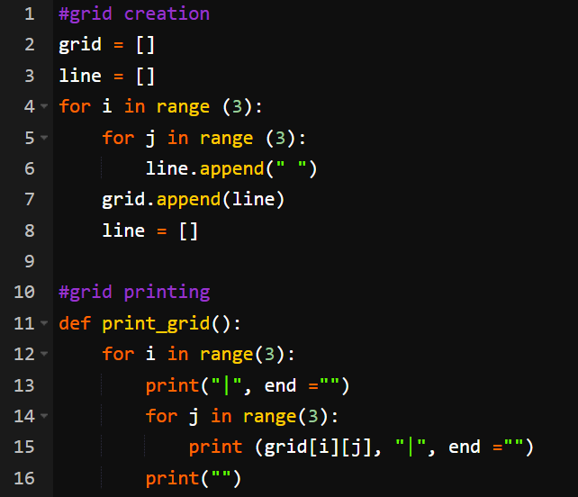
Tic-Tac-Toe Game Python Code
Notes:
#grid creation
grid = []
line = []
for i in range (3):
for j in range (3):
line.append(" ")
grid.append(line)
line = []
#grid printing
def print_grid():
for i in range(3):
print("|", end ="")
for j in range(3):
print (grid[i][j], "|", end ="")
print("")
#player turn
def player_turn(turn_player1):
if turn_player1 == True:
turn_player1 = False
print(f"It's {player2}'s turn")
else:
turn_player1 = True
print(f"It's {player1}'s turn")
return turn_player1
#choosing cell
def write_cell(cell):
cell -= 1
i = int(cell / 3)
j = cell % 3
if turn_player1 == True:
grid[i][j] = player1_symbol
else:
grid[i][j] = player2_symbol
return grid
#checking cell
def free_cell(cell):
cell -= 1
i = int(cell / 3)
j = cell % 3
if grid[i][j] == player1_symbol or grid[i][j] == player2_symbol:
print("This cell is not free")
return False
return True
#game opening
print("Welcome to the Tic-Tac-Toe !")
print("")
print_grid()
print("")
player1 = input("Please enter name of player 1 : ")
player1_symbol = input("Please enter the symbol of player 1 : ")
player2 = input("Please enter name of player 2 : ")
player2_symbol = input("Please enter the symbol of player 2 : ")
game = True
full_grid = False
turn_player1 = False
winner = ""
#win check
def win_check(grid, player1_symbol, player2_symbol):
full_grid = True
player1_symbol_count = 0
player2_symbol_count = 0
#checking rows
for i in range(3):
for j in range(3):
if grid[i][j] == player1_symbol:
player1_symbol_count += 1
player2_symbol_count = 0
if player1_symbol_count == 3:
game = False
winner = player1
return game, winner
if grid[i][j] == player2_symbol:
player2_symbol_count += 1
player1_symbol_count = 0
if player2_symbol_count == 3:
game = False
winner = player2
return game, winner
if grid[i][j] == " ":
full_grid = False
player1_symbol_count = 0
player2_symbol_count = 0
#checking columns
player1_symbol_count = 0
player2_symbol_count = 0
for i in range (3):
for j in range (3):
for k in range (3):
if i + k <= 2:
if grid[i + k][j] == player1_symbol:
player1_symbol_count += 1
player2_symbol_count = 0
if player1_symbol_count == 3:
game = False
winner = player1
return game, winner
if grid[i + k][j] == player2_symbol:
player2_symbol_count += 1
player1_symbol_count = 0
if player2_symbol_count == 3:
game = False
winner = player2
return game, winner
if grid[i][j] == " ":
full_grid = False
player1_symbol_count = 0
player2_symbol_count = 0
#checking diagonals
player1_symbol_count = 0
player2_symbol_count = 0
for i in range (3):
for j in range (3):
for k in range (3):
if j + k <= 2 and i + k <= 2:
if grid[i + k][j + k] == player1_symbol:
player1_symbol_count += 1
player2_symbol_count = 0
if player1_symbol_count == 3:
game = False
winner = player1
return game, winner
if grid[i + k][j + k] == player2_symbol:
player2_symbol_count += 1
player1_symbol_count = 0
if player2_symbol_count == 3:
game = False
winner = player2
return game, winner
if grid[i][j] == " ":
full_grid = False
player1_symbol_count = 0
player2_symbol_count = 0
player1_symbol_count = 0
player2_symbol_count = 0
for i in range (3):
for j in range (3):
for k in range (3):
if j - k >= 0 and i + k <= 2:
if grid[i + k][j - k] == player1_symbol:
player1_symbol_count += 1
player2_symbol_count = 0
if player1_symbol_count == 3:
game = False
winner = player1
return game, winner
if grid[i + k][j - k] == player2_symbol:
player2_symbol_count += 1
player1_symbol_count = 0
if player2_symbol_count == 3:
game = False
winner = player2
return game, winner
if grid[i][j] == " ":
full_grid = False
player1_symbol_count = 0
player2_symbol_count = 0
#full grid or not
if full_grid == True:
game = False
winner = ""
return game, winner
else:
game = True
winner = ""
return game, winner
#game
while game == True:
turn_player1 = player_turn(turn_player1)
free_box = False
while free_box == False:
cell = int(input("Please enter a number for your case (1 to 9 from left to right and from top to bottom) : "))
free_box = free_cell(cell)
grid = write_cell(cell)
print_grid()
game, winner = win_check(grid, player1_symbol, player2_symbol)
#end of game
if winner == player1:
print(f"Winner is {player1} !")
elif winner == player2:
print(f"Winner is {player2} !")
else:
print(f"Grid is full : equality for {player1} and {player2} !")

Slide 24
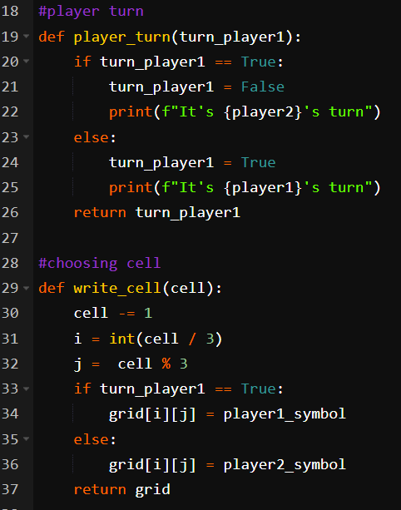
Tic-Tac-Toe Game Python Code (cont..)
Notes:
#grid creation
grid = []
line = []
for i in range (3):
for j in range (3):
line.append(" ")
grid.append(line)
line = []
#grid printing
def print_grid():
for i in range(3):
print("|", end ="")
for j in range(3):
print (grid[i][j], "|", end ="")
print("")
#player turn
def player_turn(turn_player1):
if turn_player1 == True:
turn_player1 = False
print(f"It's {player2}'s turn")
else:
turn_player1 = True
print(f"It's {player1}'s turn")
return turn_player1
#choosing cell
def write_cell(cell):
cell -= 1
i = int(cell / 3)
j = cell % 3
if turn_player1 == True:
grid[i][j] = player1_symbol
else:
grid[i][j] = player2_symbol
return grid
#checking cell
def free_cell(cell):
cell -= 1
i = int(cell / 3)
j = cell % 3
if grid[i][j] == player1_symbol or grid[i][j] == player2_symbol:
print("This cell is not free")
return False
return True
#game opening
print("Welcome to the Tic-Tac-Toe !")
print("")
print_grid()
print("")
player1 = input("Please enter name of player 1 : ")
player1_symbol = input("Please enter the symbol of player 1 : ")
player2 = input("Please enter name of player 2 : ")
player2_symbol = input("Please enter the symbol of player 2 : ")
game = True
full_grid = False
turn_player1 = False
winner = ""
#win check
def win_check(grid, player1_symbol, player2_symbol):
full_grid = True
player1_symbol_count = 0
player2_symbol_count = 0
#checking rows
for i in range(3):
for j in range(3):
if grid[i][j] == player1_symbol:
player1_symbol_count += 1
player2_symbol_count = 0
if player1_symbol_count == 3:
game = False
winner = player1
return game, winner
if grid[i][j] == player2_symbol:
player2_symbol_count += 1
player1_symbol_count = 0
if player2_symbol_count == 3:
game = False
winner = player2
return game, winner
if grid[i][j] == " ":
full_grid = False
player1_symbol_count = 0
player2_symbol_count = 0
#checking columns
player1_symbol_count = 0
player2_symbol_count = 0
for i in range (3):
for j in range (3):
for k in range (3):
if i + k <= 2:
if grid[i + k][j] == player1_symbol:
player1_symbol_count += 1
player2_symbol_count = 0
if player1_symbol_count == 3:
game = False
winner = player1
return game, winner
if grid[i + k][j] == player2_symbol:
player2_symbol_count += 1
player1_symbol_count = 0
if player2_symbol_count == 3:
game = False
winner = player2
return game, winner
if grid[i][j] == " ":
full_grid = False
player1_symbol_count = 0
player2_symbol_count = 0
#checking diagonals
player1_symbol_count = 0
player2_symbol_count = 0
for i in range (3):
for j in range (3):
for k in range (3):
if j + k <= 2 and i + k <= 2:
if grid[i + k][j + k] == player1_symbol:
player1_symbol_count += 1
player2_symbol_count = 0
if player1_symbol_count == 3:
game = False
winner = player1
return game, winner
if grid[i + k][j + k] == player2_symbol:
player2_symbol_count += 1
player1_symbol_count = 0
if player2_symbol_count == 3:
game = False
winner = player2
return game, winner
if grid[i][j] == " ":
full_grid = False
player1_symbol_count = 0
player2_symbol_count = 0
player1_symbol_count = 0
player2_symbol_count = 0
for i in range (3):
for j in range (3):
for k in range (3):
if j - k >= 0 and i + k <= 2:
if grid[i + k][j - k] == player1_symbol:
player1_symbol_count += 1
player2_symbol_count = 0
if player1_symbol_count == 3:
game = False
winner = player1
return game, winner
if grid[i + k][j - k] == player2_symbol:
player2_symbol_count += 1
player1_symbol_count = 0
if player2_symbol_count == 3:
game = False
winner = player2
return game, winner
if grid[i][j] == " ":
full_grid = False
player1_symbol_count = 0
player2_symbol_count = 0
#full grid or not
if full_grid == True:
game = False
winner = ""
return game, winner
else:
game = True
winner = ""
return game, winner
#game
while game == True:
turn_player1 = player_turn(turn_player1)
free_box = False
while free_box == False:
cell = int(input("Please enter a number for your case (1 to 9 from left to right and from top to bottom) : "))
free_box = free_cell(cell)
grid = write_cell(cell)
print_grid()
game, winner = win_check(grid, player1_symbol, player2_symbol)
#end of game
if winner == player1:
print(f"Winner is {player1} !")
elif winner == player2:
print(f"Winner is {player2} !")
else:
print(f"Grid is full : equality for {player1} and {player2} !")

Slide 25
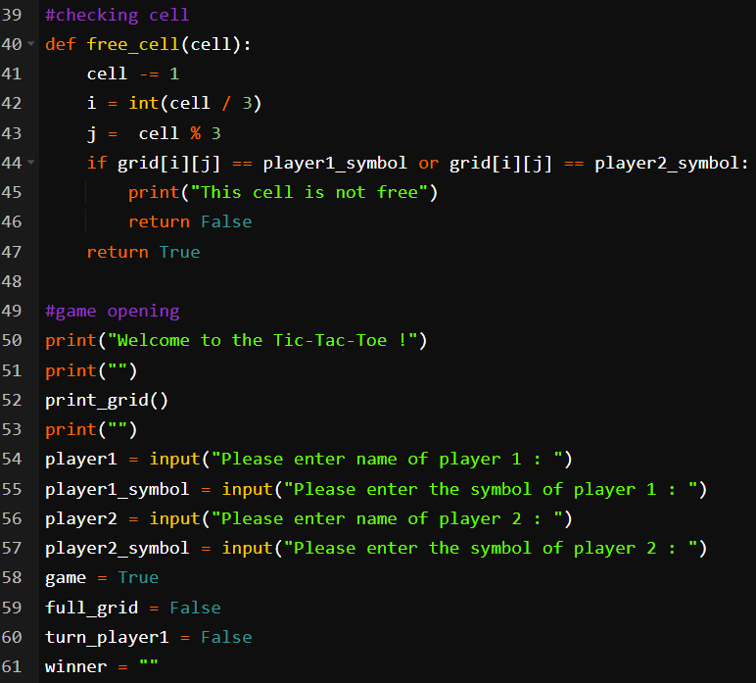
Tic-Tac-Toe Game Python Code (cont..)
Notes:
#grid creation
grid = []
line = []
for i in range (3):
for j in range (3):
line.append(" ")
grid.append(line)
line = []
#grid printing
def print_grid():
for i in range(3):
print("|", end ="")
for j in range(3):
print (grid[i][j], "|", end ="")
print("")
#player turn
def player_turn(turn_player1):
if turn_player1 == True:
turn_player1 = False
print(f"It's {player2}'s turn")
else:
turn_player1 = True
print(f"It's {player1}'s turn")
return turn_player1
#choosing cell
def write_cell(cell):
cell -= 1
i = int(cell / 3)
j = cell % 3
if turn_player1 == True:
grid[i][j] = player1_symbol
else:
grid[i][j] = player2_symbol
return grid
#checking cell
def free_cell(cell):
cell -= 1
i = int(cell / 3)
j = cell % 3
if grid[i][j] == player1_symbol or grid[i][j] == player2_symbol:
print("This cell is not free")
return False
return True
#game opening
print("Welcome to the Tic-Tac-Toe !")
print("")
print_grid()
print("")
player1 = input("Please enter name of player 1 : ")
player1_symbol = input("Please enter the symbol of player 1 : ")
player2 = input("Please enter name of player 2 : ")
player2_symbol = input("Please enter the symbol of player 2 : ")
game = True
full_grid = False
turn_player1 = False
winner = ""
#win check
def win_check(grid, player1_symbol, player2_symbol):
full_grid = True
player1_symbol_count = 0
player2_symbol_count = 0
#checking rows
for i in range(3):
for j in range(3):
if grid[i][j] == player1_symbol:
player1_symbol_count += 1
player2_symbol_count = 0
if player1_symbol_count == 3:
game = False
winner = player1
return game, winner
if grid[i][j] == player2_symbol:
player2_symbol_count += 1
player1_symbol_count = 0
if player2_symbol_count == 3:
game = False
winner = player2
return game, winner
if grid[i][j] == " ":
full_grid = False
player1_symbol_count = 0
player2_symbol_count = 0
#checking columns
player1_symbol_count = 0
player2_symbol_count = 0
for i in range (3):
for j in range (3):
for k in range (3):
if i + k <= 2:
if grid[i + k][j] == player1_symbol:
player1_symbol_count += 1
player2_symbol_count = 0
if player1_symbol_count == 3:
game = False
winner = player1
return game, winner
if grid[i + k][j] == player2_symbol:
player2_symbol_count += 1
player1_symbol_count = 0
if player2_symbol_count == 3:
game = False
winner = player2
return game, winner
if grid[i][j] == " ":
full_grid = False
player1_symbol_count = 0
player2_symbol_count = 0
#checking diagonals
player1_symbol_count = 0
player2_symbol_count = 0
for i in range (3):
for j in range (3):
for k in range (3):
if j + k <= 2 and i + k <= 2:
if grid[i + k][j + k] == player1_symbol:
player1_symbol_count += 1
player2_symbol_count = 0
if player1_symbol_count == 3:
game = False
winner = player1
return game, winner
if grid[i + k][j + k] == player2_symbol:
player2_symbol_count += 1
player1_symbol_count = 0
if player2_symbol_count == 3:
game = False
winner = player2
return game, winner
if grid[i][j] == " ":
full_grid = False
player1_symbol_count = 0
player2_symbol_count = 0
player1_symbol_count = 0
player2_symbol_count = 0
for i in range (3):
for j in range (3):
for k in range (3):
if j - k >= 0 and i + k <= 2:
if grid[i + k][j - k] == player1_symbol:
player1_symbol_count += 1
player2_symbol_count = 0
if player1_symbol_count == 3:
game = False
winner = player1
return game, winner
if grid[i + k][j - k] == player2_symbol:
player2_symbol_count += 1
player1_symbol_count = 0
if player2_symbol_count == 3:
game = False
winner = player2
return game, winner
if grid[i][j] == " ":
full_grid = False
player1_symbol_count = 0
player2_symbol_count = 0
#full grid or not
if full_grid == True:
game = False
winner = ""
return game, winner
else:
game = True
winner = ""
return game, winner
#game
while game == True:
turn_player1 = player_turn(turn_player1)
free_box = False
while free_box == False:
cell = int(input("Please enter a number for your case (1 to 9 from left to right and from top to bottom) : "))
free_box = free_cell(cell)
grid = write_cell(cell)
print_grid()
game, winner = win_check(grid, player1_symbol, player2_symbol)
#end of game
if winner == player1:
print(f"Winner is {player1} !")
elif winner == player2:
print(f"Winner is {player2} !")
else:
print(f"Grid is full : equality for {player1} and {player2} !")

Slide 26
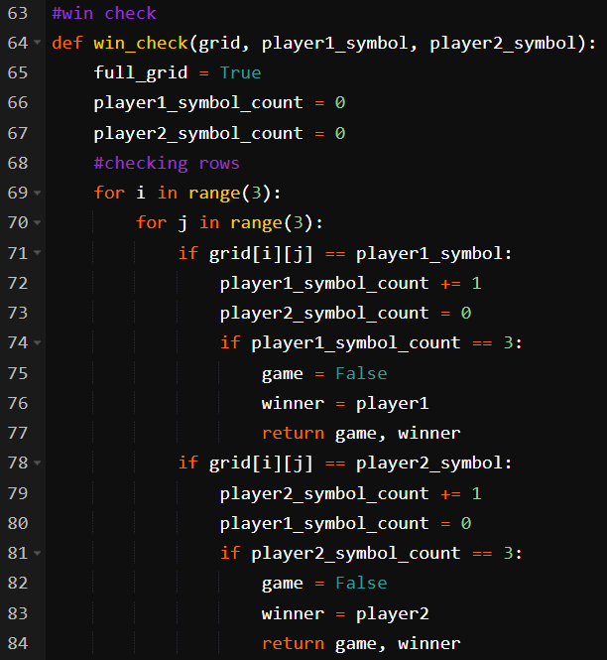
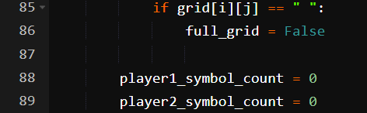
Tic-Tac-Toe Game Python Code (cont..)
Notes:
#grid creation
grid = []
line = []
for i in range (3):
for j in range (3):
line.append(" ")
grid.append(line)
line = []
#grid printing
def print_grid():
for i in range(3):
print("|", end ="")
for j in range(3):
print (grid[i][j], "|", end ="")
print("")
#player turn
def player_turn(turn_player1):
if turn_player1 == True:
turn_player1 = False
print(f"It's {player2}'s turn")
else:
turn_player1 = True
print(f"It's {player1}'s turn")
return turn_player1
#choosing cell
def write_cell(cell):
cell -= 1
i = int(cell / 3)
j = cell % 3
if turn_player1 == True:
grid[i][j] = player1_symbol
else:
grid[i][j] = player2_symbol
return grid
#checking cell
def free_cell(cell):
cell -= 1
i = int(cell / 3)
j = cell % 3
if grid[i][j] == player1_symbol or grid[i][j] == player2_symbol:
print("This cell is not free")
return False
return True
#game opening
print("Welcome to the Tic-Tac-Toe !")
print("")
print_grid()
print("")
player1 = input("Please enter name of player 1 : ")
player1_symbol = input("Please enter the symbol of player 1 : ")
player2 = input("Please enter name of player 2 : ")
player2_symbol = input("Please enter the symbol of player 2 : ")
game = True
full_grid = False
turn_player1 = False
winner = ""
#win check
def win_check(grid, player1_symbol, player2_symbol):
full_grid = True
player1_symbol_count = 0
player2_symbol_count = 0
#checking rows
for i in range(3):
for j in range(3):
if grid[i][j] == player1_symbol:
player1_symbol_count += 1
player2_symbol_count = 0
if player1_symbol_count == 3:
game = False
winner = player1
return game, winner
if grid[i][j] == player2_symbol:
player2_symbol_count += 1
player1_symbol_count = 0
if player2_symbol_count == 3:
game = False
winner = player2
return game, winner
if grid[i][j] == " ":
full_grid = False
player1_symbol_count = 0
player2_symbol_count = 0
#checking columns
player1_symbol_count = 0
player2_symbol_count = 0
for i in range (3):
for j in range (3):
for k in range (3):
if i + k <= 2:
if grid[i + k][j] == player1_symbol:
player1_symbol_count += 1
player2_symbol_count = 0
if player1_symbol_count == 3:
game = False
winner = player1
return game, winner
if grid[i + k][j] == player2_symbol:
player2_symbol_count += 1
player1_symbol_count = 0
if player2_symbol_count == 3:
game = False
winner = player2
return game, winner
if grid[i][j] == " ":
full_grid = False
player1_symbol_count = 0
player2_symbol_count = 0
#checking diagonals
player1_symbol_count = 0
player2_symbol_count = 0
for i in range (3):
for j in range (3):
for k in range (3):
if j + k <= 2 and i + k <= 2:
if grid[i + k][j + k] == player1_symbol:
player1_symbol_count += 1
player2_symbol_count = 0
if player1_symbol_count == 3:
game = False
winner = player1
return game, winner
if grid[i + k][j + k] == player2_symbol:
player2_symbol_count += 1
player1_symbol_count = 0
if player2_symbol_count == 3:
game = False
winner = player2
return game, winner
if grid[i][j] == " ":
full_grid = False
player1_symbol_count = 0
player2_symbol_count = 0
player1_symbol_count = 0
player2_symbol_count = 0
for i in range (3):
for j in range (3):
for k in range (3):
if j - k >= 0 and i + k <= 2:
if grid[i + k][j - k] == player1_symbol:
player1_symbol_count += 1
player2_symbol_count = 0
if player1_symbol_count == 3:
game = False
winner = player1
return game, winner
if grid[i + k][j - k] == player2_symbol:
player2_symbol_count += 1
player1_symbol_count = 0
if player2_symbol_count == 3:
game = False
winner = player2
return game, winner
if grid[i][j] == " ":
full_grid = False
player1_symbol_count = 0
player2_symbol_count = 0
#full grid or not
if full_grid == True:
game = False
winner = ""
return game, winner
else:
game = True
winner = ""
return game, winner
#game
while game == True:
turn_player1 = player_turn(turn_player1)
free_box = False
while free_box == False:
cell = int(input("Please enter a number for your case (1 to 9 from left to right and from top to bottom) : "))
free_box = free_cell(cell)
grid = write_cell(cell)
print_grid()
game, winner = win_check(grid, player1_symbol, player2_symbol)
#end of game
if winner == player1:
print(f"Winner is {player1} !")
elif winner == player2:
print(f"Winner is {player2} !")
else:
print(f"Grid is full : equality for {player1} and {player2} !")

Slide 27
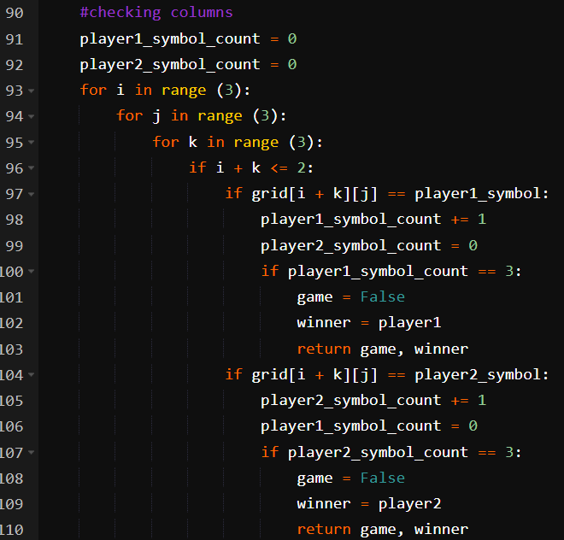
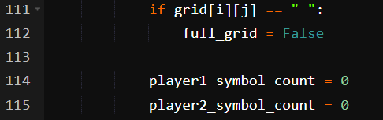
Tic-Tac-Toe Game Python Code (cont..)
Notes:
#grid creation
grid = []
line = []
for i in range (3):
for j in range (3):
line.append(" ")
grid.append(line)
line = []
#grid printing
def print_grid():
for i in range(3):
print("|", end ="")
for j in range(3):
print (grid[i][j], "|", end ="")
print("")
#player turn
def player_turn(turn_player1):
if turn_player1 == True:
turn_player1 = False
print(f"It's {player2}'s turn")
else:
turn_player1 = True
print(f"It's {player1}'s turn")
return turn_player1
#choosing cell
def write_cell(cell):
cell -= 1
i = int(cell / 3)
j = cell % 3
if turn_player1 == True:
grid[i][j] = player1_symbol
else:
grid[i][j] = player2_symbol
return grid
#checking cell
def free_cell(cell):
cell -= 1
i = int(cell / 3)
j = cell % 3
if grid[i][j] == player1_symbol or grid[i][j] == player2_symbol:
print("This cell is not free")
return False
return True
#game opening
print("Welcome to the Tic-Tac-Toe !")
print("")
print_grid()
print("")
player1 = input("Please enter name of player 1 : ")
player1_symbol = input("Please enter the symbol of player 1 : ")
player2 = input("Please enter name of player 2 : ")
player2_symbol = input("Please enter the symbol of player 2 : ")
game = True
full_grid = False
turn_player1 = False
winner = ""
#win check
def win_check(grid, player1_symbol, player2_symbol):
full_grid = True
player1_symbol_count = 0
player2_symbol_count = 0
#checking rows
for i in range(3):
for j in range(3):
if grid[i][j] == player1_symbol:
player1_symbol_count += 1
player2_symbol_count = 0
if player1_symbol_count == 3:
game = False
winner = player1
return game, winner
if grid[i][j] == player2_symbol:
player2_symbol_count += 1
player1_symbol_count = 0
if player2_symbol_count == 3:
game = False
winner = player2
return game, winner
if grid[i][j] == " ":
full_grid = False
player1_symbol_count = 0
player2_symbol_count = 0
#checking columns
player1_symbol_count = 0
player2_symbol_count = 0
for i in range (3):
for j in range (3):
for k in range (3):
if i + k <= 2:
if grid[i + k][j] == player1_symbol:
player1_symbol_count += 1
player2_symbol_count = 0
if player1_symbol_count == 3:
game = False
winner = player1
return game, winner
if grid[i + k][j] == player2_symbol:
player2_symbol_count += 1
player1_symbol_count = 0
if player2_symbol_count == 3:
game = False
winner = player2
return game, winner
if grid[i][j] == " ":
full_grid = False
player1_symbol_count = 0
player2_symbol_count = 0
#checking diagonals
player1_symbol_count = 0
player2_symbol_count = 0
for i in range (3):
for j in range (3):
for k in range (3):
if j + k <= 2 and i + k <= 2:
if grid[i + k][j + k] == player1_symbol:
player1_symbol_count += 1
player2_symbol_count = 0
if player1_symbol_count == 3:
game = False
winner = player1
return game, winner
if grid[i + k][j + k] == player2_symbol:
player2_symbol_count += 1
player1_symbol_count = 0
if player2_symbol_count == 3:
game = False
winner = player2
return game, winner
if grid[i][j] == " ":
full_grid = False
player1_symbol_count = 0
player2_symbol_count = 0
player1_symbol_count = 0
player2_symbol_count = 0
for i in range (3):
for j in range (3):
for k in range (3):
if j - k >= 0 and i + k <= 2:
if grid[i + k][j - k] == player1_symbol:
player1_symbol_count += 1
player2_symbol_count = 0
if player1_symbol_count == 3:
game = False
winner = player1
return game, winner
if grid[i + k][j - k] == player2_symbol:
player2_symbol_count += 1
player1_symbol_count = 0
if player2_symbol_count == 3:
game = False
winner = player2
return game, winner
if grid[i][j] == " ":
full_grid = False
player1_symbol_count = 0
player2_symbol_count = 0
#full grid or not
if full_grid == True:
game = False
winner = ""
return game, winner
else:
game = True
winner = ""
return game, winner
#game
while game == True:
turn_player1 = player_turn(turn_player1)
free_box = False
while free_box == False:
cell = int(input("Please enter a number for your case (1 to 9 from left to right and from top to bottom) : "))
free_box = free_cell(cell)
grid = write_cell(cell)
print_grid()
game, winner = win_check(grid, player1_symbol, player2_symbol)
#end of game
if winner == player1:
print(f"Winner is {player1} !")
elif winner == player2:
print(f"Winner is {player2} !")
else:
print(f"Grid is full : equality for {player1} and {player2} !")

Slide 28
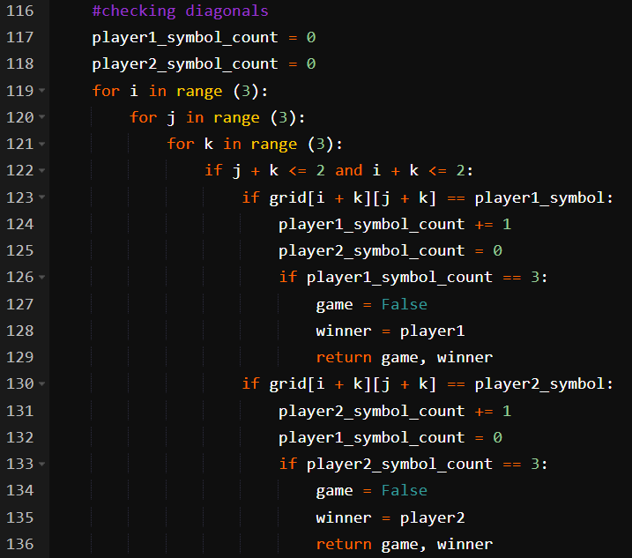
Tic-Tac-Toe Game Python Code (cont..)
Notes:
#grid creation
grid = []
line = []
for i in range (3):
for j in range (3):
line.append(" ")
grid.append(line)
line = []
#grid printing
def print_grid():
for i in range(3):
print("|", end ="")
for j in range(3):
print (grid[i][j], "|", end ="")
print("")
#player turn
def player_turn(turn_player1):
if turn_player1 == True:
turn_player1 = False
print(f"It's {player2}'s turn")
else:
turn_player1 = True
print(f"It's {player1}'s turn")
return turn_player1
#choosing cell
def write_cell(cell):
cell -= 1
i = int(cell / 3)
j = cell % 3
if turn_player1 == True:
grid[i][j] = player1_symbol
else:
grid[i][j] = player2_symbol
return grid
#checking cell
def free_cell(cell):
cell -= 1
i = int(cell / 3)
j = cell % 3
if grid[i][j] == player1_symbol or grid[i][j] == player2_symbol:
print("This cell is not free")
return False
return True
#game opening
print("Welcome to the Tic-Tac-Toe !")
print("")
print_grid()
print("")
player1 = input("Please enter name of player 1 : ")
player1_symbol = input("Please enter the symbol of player 1 : ")
player2 = input("Please enter name of player 2 : ")
player2_symbol = input("Please enter the symbol of player 2 : ")
game = True
full_grid = False
turn_player1 = False
winner = ""
#win check
def win_check(grid, player1_symbol, player2_symbol):
full_grid = True
player1_symbol_count = 0
player2_symbol_count = 0
#checking rows
for i in range(3):
for j in range(3):
if grid[i][j] == player1_symbol:
player1_symbol_count += 1
player2_symbol_count = 0
if player1_symbol_count == 3:
game = False
winner = player1
return game, winner
if grid[i][j] == player2_symbol:
player2_symbol_count += 1
player1_symbol_count = 0
if player2_symbol_count == 3:
game = False
winner = player2
return game, winner
if grid[i][j] == " ":
full_grid = False
player1_symbol_count = 0
player2_symbol_count = 0
#checking columns
player1_symbol_count = 0
player2_symbol_count = 0
for i in range (3):
for j in range (3):
for k in range (3):
if i + k <= 2:
if grid[i + k][j] == player1_symbol:
player1_symbol_count += 1
player2_symbol_count = 0
if player1_symbol_count == 3:
game = False
winner = player1
return game, winner
if grid[i + k][j] == player2_symbol:
player2_symbol_count += 1
player1_symbol_count = 0
if player2_symbol_count == 3:
game = False
winner = player2
return game, winner
if grid[i][j] == " ":
full_grid = False
player1_symbol_count = 0
player2_symbol_count = 0
#checking diagonals
player1_symbol_count = 0
player2_symbol_count = 0
for i in range (3):
for j in range (3):
for k in range (3):
if j + k <= 2 and i + k <= 2:
if grid[i + k][j + k] == player1_symbol:
player1_symbol_count += 1
player2_symbol_count = 0
if player1_symbol_count == 3:
game = False
winner = player1
return game, winner
if grid[i + k][j + k] == player2_symbol:
player2_symbol_count += 1
player1_symbol_count = 0
if player2_symbol_count == 3:
game = False
winner = player2
return game, winner
if grid[i][j] == " ":
full_grid = False
player1_symbol_count = 0
player2_symbol_count = 0
player1_symbol_count = 0
player2_symbol_count = 0
for i in range (3):
for j in range (3):
for k in range (3):
if j - k >= 0 and i + k <= 2:
if grid[i + k][j - k] == player1_symbol:
player1_symbol_count += 1
player2_symbol_count = 0
if player1_symbol_count == 3:
game = False
winner = player1
return game, winner
if grid[i + k][j - k] == player2_symbol:
player2_symbol_count += 1
player1_symbol_count = 0
if player2_symbol_count == 3:
game = False
winner = player2
return game, winner
if grid[i][j] == " ":
full_grid = False
player1_symbol_count = 0
player2_symbol_count = 0
#full grid or not
if full_grid == True:
game = False
winner = ""
return game, winner
else:
game = True
winner = ""
return game, winner
#game
while game == True:
turn_player1 = player_turn(turn_player1)
free_box = False
while free_box == False:
cell = int(input("Please enter a number for your case (1 to 9 from left to right and from top to bottom) : "))
free_box = free_cell(cell)
grid = write_cell(cell)
print_grid()
game, winner = win_check(grid, player1_symbol, player2_symbol)
#end of game
if winner == player1:
print(f"Winner is {player1} !")
elif winner == player2:
print(f"Winner is {player2} !")
else:
print(f"Grid is full : equality for {player1} and {player2} !")

Slide 29
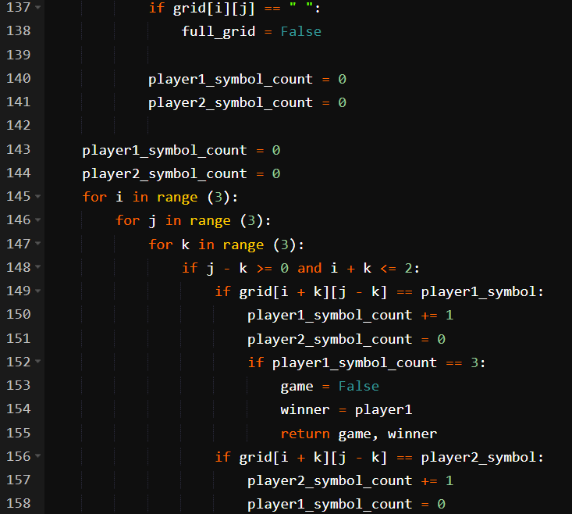
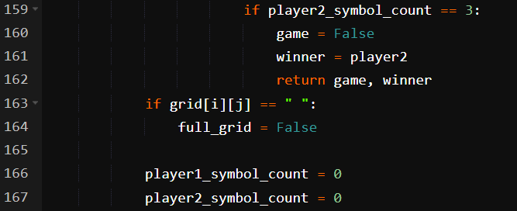
Tic-Tac-Toe Game Python Code (cont..)
Notes:
#grid creation
grid = []
line = []
for i in range (3):
for j in range (3):
line.append(" ")
grid.append(line)
line = []
#grid printing
def print_grid():
for i in range(3):
print("|", end ="")
for j in range(3):
print (grid[i][j], "|", end ="")
print("")
#player turn
def player_turn(turn_player1):
if turn_player1 == True:
turn_player1 = False
print(f"It's {player2}'s turn")
else:
turn_player1 = True
print(f"It's {player1}'s turn")
return turn_player1
#choosing cell
def write_cell(cell):
cell -= 1
i = int(cell / 3)
j = cell % 3
if turn_player1 == True:
grid[i][j] = player1_symbol
else:
grid[i][j] = player2_symbol
return grid
#checking cell
def free_cell(cell):
cell -= 1
i = int(cell / 3)
j = cell % 3
if grid[i][j] == player1_symbol or grid[i][j] == player2_symbol:
print("This cell is not free")
return False
return True
#game opening
print("Welcome to the Tic-Tac-Toe !")
print("")
print_grid()
print("")
player1 = input("Please enter name of player 1 : ")
player1_symbol = input("Please enter the symbol of player 1 : ")
player2 = input("Please enter name of player 2 : ")
player2_symbol = input("Please enter the symbol of player 2 : ")
game = True
full_grid = False
turn_player1 = False
winner = ""
#win check
def win_check(grid, player1_symbol, player2_symbol):
full_grid = True
player1_symbol_count = 0
player2_symbol_count = 0
#checking rows
for i in range(3):
for j in range(3):
if grid[i][j] == player1_symbol:
player1_symbol_count += 1
player2_symbol_count = 0
if player1_symbol_count == 3:
game = False
winner = player1
return game, winner
if grid[i][j] == player2_symbol:
player2_symbol_count += 1
player1_symbol_count = 0
if player2_symbol_count == 3:
game = False
winner = player2
return game, winner
if grid[i][j] == " ":
full_grid = False
player1_symbol_count = 0
player2_symbol_count = 0
#checking columns
player1_symbol_count = 0
player2_symbol_count = 0
for i in range (3):
for j in range (3):
for k in range (3):
if i + k <= 2:
if grid[i + k][j] == player1_symbol:
player1_symbol_count += 1
player2_symbol_count = 0
if player1_symbol_count == 3:
game = False
winner = player1
return game, winner
if grid[i + k][j] == player2_symbol:
player2_symbol_count += 1
player1_symbol_count = 0
if player2_symbol_count == 3:
game = False
winner = player2
return game, winner
if grid[i][j] == " ":
full_grid = False
player1_symbol_count = 0
player2_symbol_count = 0
#checking diagonals
player1_symbol_count = 0
player2_symbol_count = 0
for i in range (3):
for j in range (3):
for k in range (3):
if j + k <= 2 and i + k <= 2:
if grid[i + k][j + k] == player1_symbol:
player1_symbol_count += 1
player2_symbol_count = 0
if player1_symbol_count == 3:
game = False
winner = player1
return game, winner
if grid[i + k][j + k] == player2_symbol:
player2_symbol_count += 1
player1_symbol_count = 0
if player2_symbol_count == 3:
game = False
winner = player2
return game, winner
if grid[i][j] == " ":
full_grid = False
player1_symbol_count = 0
player2_symbol_count = 0
player1_symbol_count = 0
player2_symbol_count = 0
for i in range (3):
for j in range (3):
for k in range (3):
if j - k >= 0 and i + k <= 2:
if grid[i + k][j - k] == player1_symbol:
player1_symbol_count += 1
player2_symbol_count = 0
if player1_symbol_count == 3:
game = False
winner = player1
return game, winner
if grid[i + k][j - k] == player2_symbol:
player2_symbol_count += 1
player1_symbol_count = 0
if player2_symbol_count == 3:
game = False
winner = player2
return game, winner
if grid[i][j] == " ":
full_grid = False
player1_symbol_count = 0
player2_symbol_count = 0
#full grid or not
if full_grid == True:
game = False
winner = ""
return game, winner
else:
game = True
winner = ""
return game, winner
#game
while game == True:
turn_player1 = player_turn(turn_player1)
free_box = False
while free_box == False:
cell = int(input("Please enter a number for your case (1 to 9 from left to right and from top to bottom) : "))
free_box = free_cell(cell)
grid = write_cell(cell)
print_grid()
game, winner = win_check(grid, player1_symbol, player2_symbol)
#end of game
if winner == player1:
print(f"Winner is {player1} !")
elif winner == player2:
print(f"Winner is {player2} !")
else:
print(f"Grid is full : equality for {player1} and {player2} !")

Slide 30
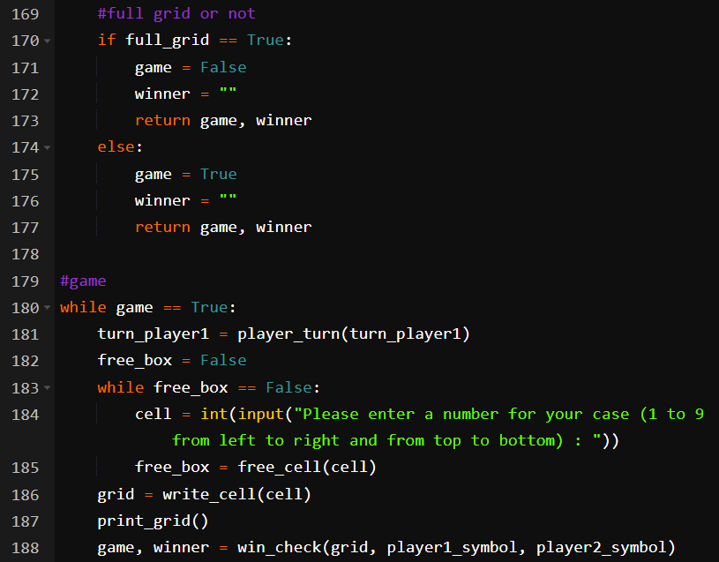
Tic-Tac-Toe Game Python Code (cont..)
Notes:
#grid creation
grid = []
line = []
for i in range (3):
for j in range (3):
line.append(" ")
grid.append(line)
line = []
#grid printing
def print_grid():
for i in range(3):
print("|", end ="")
for j in range(3):
print (grid[i][j], "|", end ="")
print("")
#player turn
def player_turn(turn_player1):
if turn_player1 == True:
turn_player1 = False
print(f"It's {player2}'s turn")
else:
turn_player1 = True
print(f"It's {player1}'s turn")
return turn_player1
#choosing cell
def write_cell(cell):
cell -= 1
i = int(cell / 3)
j = cell % 3
if turn_player1 == True:
grid[i][j] = player1_symbol
else:
grid[i][j] = player2_symbol
return grid
#checking cell
def free_cell(cell):
cell -= 1
i = int(cell / 3)
j = cell % 3
if grid[i][j] == player1_symbol or grid[i][j] == player2_symbol:
print("This cell is not free")
return False
return True
#game opening
print("Welcome to the Tic-Tac-Toe !")
print("")
print_grid()
print("")
player1 = input("Please enter name of player 1 : ")
player1_symbol = input("Please enter the symbol of player 1 : ")
player2 = input("Please enter name of player 2 : ")
player2_symbol = input("Please enter the symbol of player 2 : ")
game = True
full_grid = False
turn_player1 = False
winner = ""
#win check
def win_check(grid, player1_symbol, player2_symbol):
full_grid = True
player1_symbol_count = 0
player2_symbol_count = 0
#checking rows
for i in range(3):
for j in range(3):
if grid[i][j] == player1_symbol:
player1_symbol_count += 1
player2_symbol_count = 0
if player1_symbol_count == 3:
game = False
winner = player1
return game, winner
if grid[i][j] == player2_symbol:
player2_symbol_count += 1
player1_symbol_count = 0
if player2_symbol_count == 3:
game = False
winner = player2
return game, winner
if grid[i][j] == " ":
full_grid = False
player1_symbol_count = 0
player2_symbol_count = 0
#checking columns
player1_symbol_count = 0
player2_symbol_count = 0
for i in range (3):
for j in range (3):
for k in range (3):
if i + k <= 2:
if grid[i + k][j] == player1_symbol:
player1_symbol_count += 1
player2_symbol_count = 0
if player1_symbol_count == 3:
game = False
winner = player1
return game, winner
if grid[i + k][j] == player2_symbol:
player2_symbol_count += 1
player1_symbol_count = 0
if player2_symbol_count == 3:
game = False
winner = player2
return game, winner
if grid[i][j] == " ":
full_grid = False
player1_symbol_count = 0
player2_symbol_count = 0
#checking diagonals
player1_symbol_count = 0
player2_symbol_count = 0
for i in range (3):
for j in range (3):
for k in range (3):
if j + k <= 2 and i + k <= 2:
if grid[i + k][j + k] == player1_symbol:
player1_symbol_count += 1
player2_symbol_count = 0
if player1_symbol_count == 3:
game = False
winner = player1
return game, winner
if grid[i + k][j + k] == player2_symbol:
player2_symbol_count += 1
player1_symbol_count = 0
if player2_symbol_count == 3:
game = False
winner = player2
return game, winner
if grid[i][j] == " ":
full_grid = False
player1_symbol_count = 0
player2_symbol_count = 0
player1_symbol_count = 0
player2_symbol_count = 0
for i in range (3):
for j in range (3):
for k in range (3):
if j - k >= 0 and i + k <= 2:
if grid[i + k][j - k] == player1_symbol:
player1_symbol_count += 1
player2_symbol_count = 0
if player1_symbol_count == 3:
game = False
winner = player1
return game, winner
if grid[i + k][j - k] == player2_symbol:
player2_symbol_count += 1
player1_symbol_count = 0
if player2_symbol_count == 3:
game = False
winner = player2
return game, winner
if grid[i][j] == " ":
full_grid = False
player1_symbol_count = 0
player2_symbol_count = 0
#full grid or not
if full_grid == True:
game = False
winner = ""
return game, winner
else:
game = True
winner = ""
return game, winner
#game
while game == True:
turn_player1 = player_turn(turn_player1)
free_box = False
while free_box == False:
cell = int(input("Please enter a number for your case (1 to 9 from left to right and from top to bottom) : "))
free_box = free_cell(cell)
grid = write_cell(cell)
print_grid()
game, winner = win_check(grid, player1_symbol, player2_symbol)
#end of game
if winner == player1:
print(f"Winner is {player1} !")
elif winner == player2:
print(f"Winner is {player2} !")
else:
print(f"Grid is full : equality for {player1} and {player2} !")

Slide 31
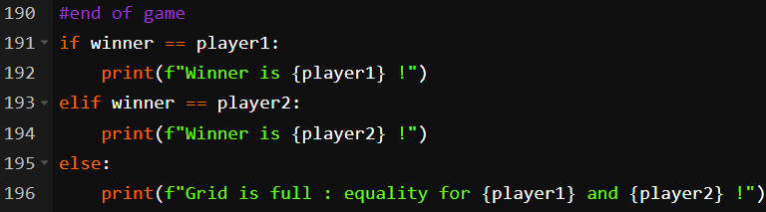
Tic-Tac-Toe Game Python Code (cont..)
Your Task➔ Develop Tic-Tac-Toe Game using class
Notes:
#grid creation
grid = []
line = []
for i in range (3):
for j in range (3):
line.append(" ")
grid.append(line)
line = []
#grid printing
def print_grid():
for i in range(3):
print("|", end ="")
for j in range(3):
print (grid[i][j], "|", end ="")
print("")
#player turn
def player_turn(turn_player1):
if turn_player1 == True:
turn_player1 = False
print(f"It's {player2}'s turn")
else:
turn_player1 = True
print(f"It's {player1}'s turn")
return turn_player1
#choosing cell
def write_cell(cell):
cell -= 1
i = int(cell / 3)
j = cell % 3
if turn_player1 == True:
grid[i][j] = player1_symbol
else:
grid[i][j] = player2_symbol
return grid
#checking cell
def free_cell(cell):
cell -= 1
i = int(cell / 3)
j = cell % 3
if grid[i][j] == player1_symbol or grid[i][j] == player2_symbol:
print("This cell is not free")
return False
return True
#game opening
print("Welcome to the Tic-Tac-Toe !")
print("")
print_grid()
print("")
player1 = input("Please enter name of player 1 : ")
player1_symbol = input("Please enter the symbol of player 1 : ")
player2 = input("Please enter name of player 2 : ")
player2_symbol = input("Please enter the symbol of player 2 : ")
game = True
full_grid = False
turn_player1 = False
winner = ""
#win check
def win_check(grid, player1_symbol, player2_symbol):
full_grid = True
player1_symbol_count = 0
player2_symbol_count = 0
#checking rows
for i in range(3):
for j in range(3):
if grid[i][j] == player1_symbol:
player1_symbol_count += 1
player2_symbol_count = 0
if player1_symbol_count == 3:
game = False
winner = player1
return game, winner
if grid[i][j] == player2_symbol:
player2_symbol_count += 1
player1_symbol_count = 0
if player2_symbol_count == 3:
game = False
winner = player2
return game, winner
if grid[i][j] == " ":
full_grid = False
player1_symbol_count = 0
player2_symbol_count = 0
#checking columns
player1_symbol_count = 0
player2_symbol_count = 0
for i in range (3):
for j in range (3):
for k in range (3):
if i + k <= 2:
if grid[i + k][j] == player1_symbol:
player1_symbol_count += 1
player2_symbol_count = 0
if player1_symbol_count == 3:
game = False
winner = player1
return game, winner
if grid[i + k][j] == player2_symbol:
player2_symbol_count += 1
player1_symbol_count = 0
if player2_symbol_count == 3:
game = False
winner = player2
return game, winner
if grid[i][j] == " ":
full_grid = False
player1_symbol_count = 0
player2_symbol_count = 0
#checking diagonals
player1_symbol_count = 0
player2_symbol_count = 0
for i in range (3):
for j in range (3):
for k in range (3):
if j + k <= 2 and i + k <= 2:
if grid[i + k][j + k] == player1_symbol:
player1_symbol_count += 1
player2_symbol_count = 0
if player1_symbol_count == 3:
game = False
winner = player1
return game, winner
if grid[i + k][j + k] == player2_symbol:
player2_symbol_count += 1
player1_symbol_count = 0
if player2_symbol_count == 3:
game = False
winner = player2
return game, winner
if grid[i][j] == " ":
full_grid = False
player1_symbol_count = 0
player2_symbol_count = 0
player1_symbol_count = 0
player2_symbol_count = 0
for i in range (3):
for j in range (3):
for k in range (3):
if j - k >= 0 and i + k <= 2:
if grid[i + k][j - k] == player1_symbol:
player1_symbol_count += 1
player2_symbol_count = 0
if player1_symbol_count == 3:
game = False
winner = player1
return game, winner
if grid[i + k][j - k] == player2_symbol:
player2_symbol_count += 1
player1_symbol_count = 0
if player2_symbol_count == 3:
game = False
winner = player2
return game, winner
if grid[i][j] == " ":
full_grid = False
player1_symbol_count = 0
player2_symbol_count = 0
#full grid or not
if full_grid == True:
game = False
winner = ""
return game, winner
else:
game = True
winner = ""
return game, winner
#game
while game == True:
turn_player1 = player_turn(turn_player1)
free_box = False
while free_box == False:
cell = int(input("Please enter a number for your case (1 to 9 from left to right and from top to bottom) : "))
free_box = free_cell(cell)
grid = write_cell(cell)
print_grid()
game, winner = win_check(grid, player1_symbol, player2_symbol)
#end of game
if winner == player1:
print(f"Winner is {player1} !")
elif winner == player2:
print(f"Winner is {player2} !")
else:
print(f"Grid is full : equality for {player1} and {player2} !")

Slide 32
The end

